Slide 1

Python
Raghu Prasad K S

Slide 2
Course Outline
Introduction to Python
Installation of Python and getting started with python
Features of Python – Sequences
Introduction to IDE and Installation of Anaconda
Object Orientation
File Operations
Networked Programs
Using Webservices
Using Database and SQL

Slide 3
Installation of Python
Download python from https://www.python.org/downloads/
Download Python 3.6.4
Install the executable

Slide 4
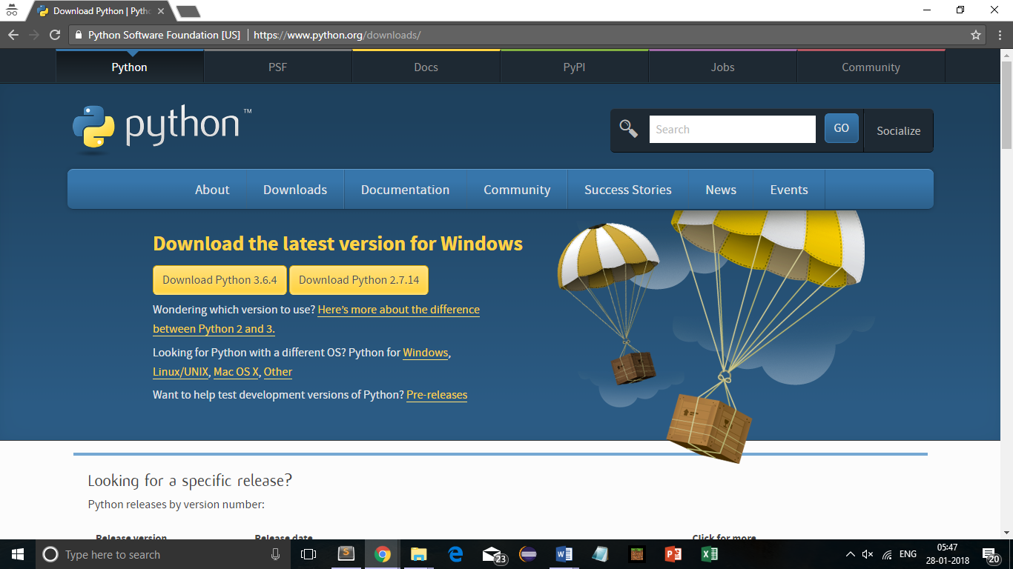
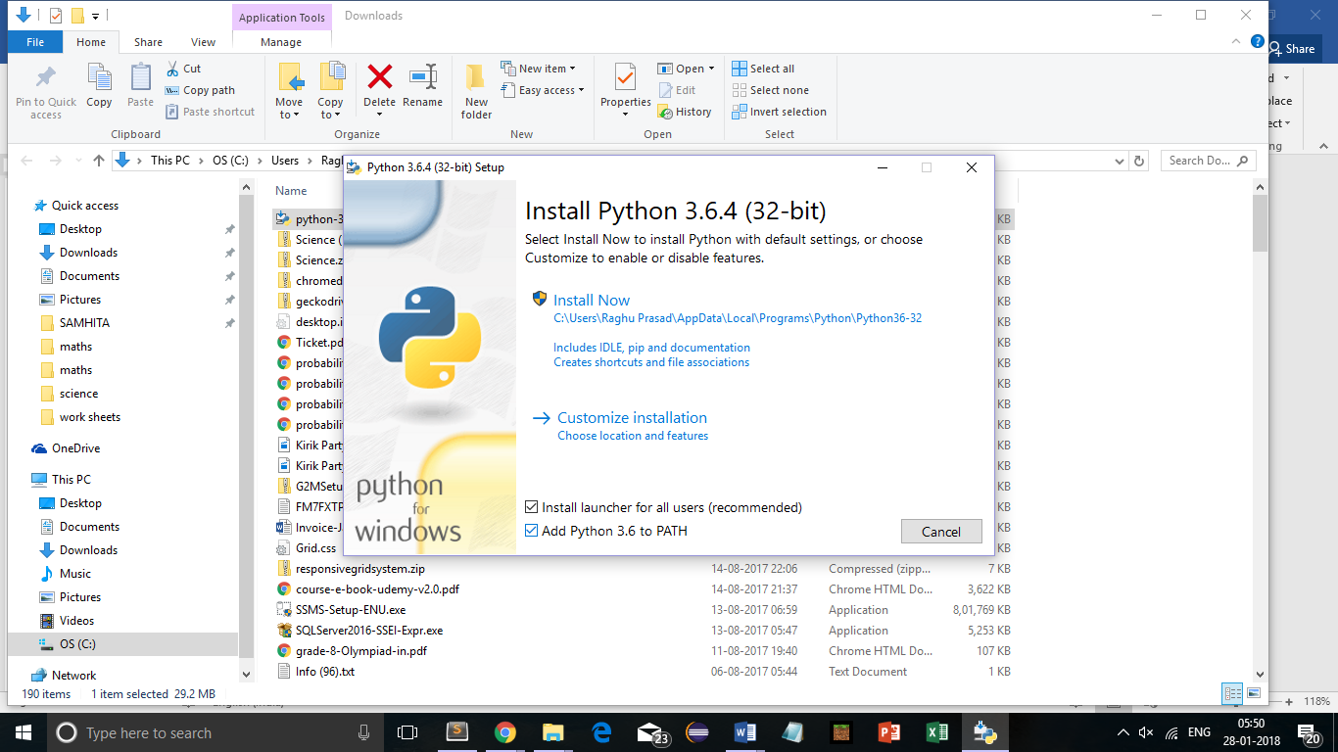
Installation of Python - Continued

Slide 5
Getting started
Check the version
python --version
Getting started with simple programs
Type python in command prompt
print(‘Welcome to Python’)
Type exit() or control Z to come out of the python
Help
Type help() or help(‘object’) ex-help(‘list’),help keywords
Type q to come out
dir – dir(list)

Slide 6
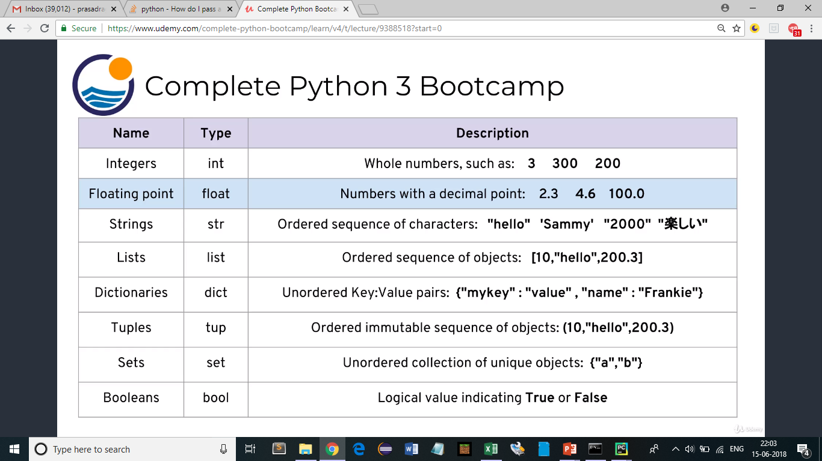
Data types

Slide 7
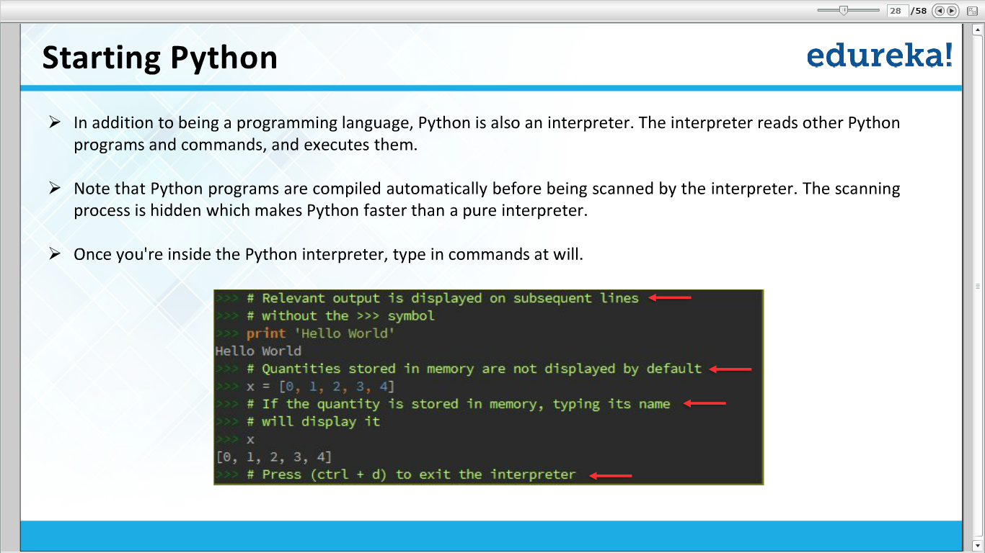

Slide 8
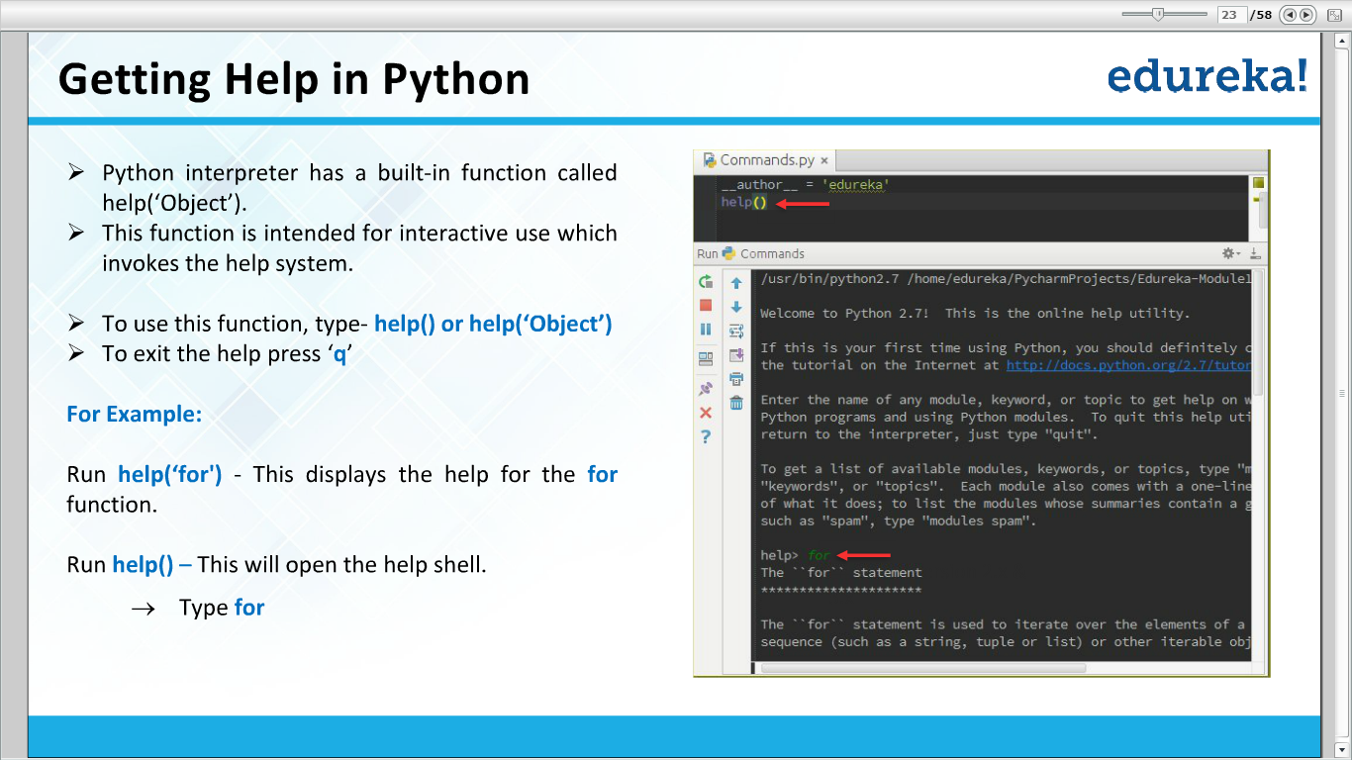

Slide 9
Getting started
Simple addition
a=10
b=20
a+b
print(a+b)
Assigning names
firstname=‘raghu’
lastname=‘prasad’
print(firstname+lastname)
Create file myfirstprogram.py
run program by typing python myfirstprogram.py

Slide 10
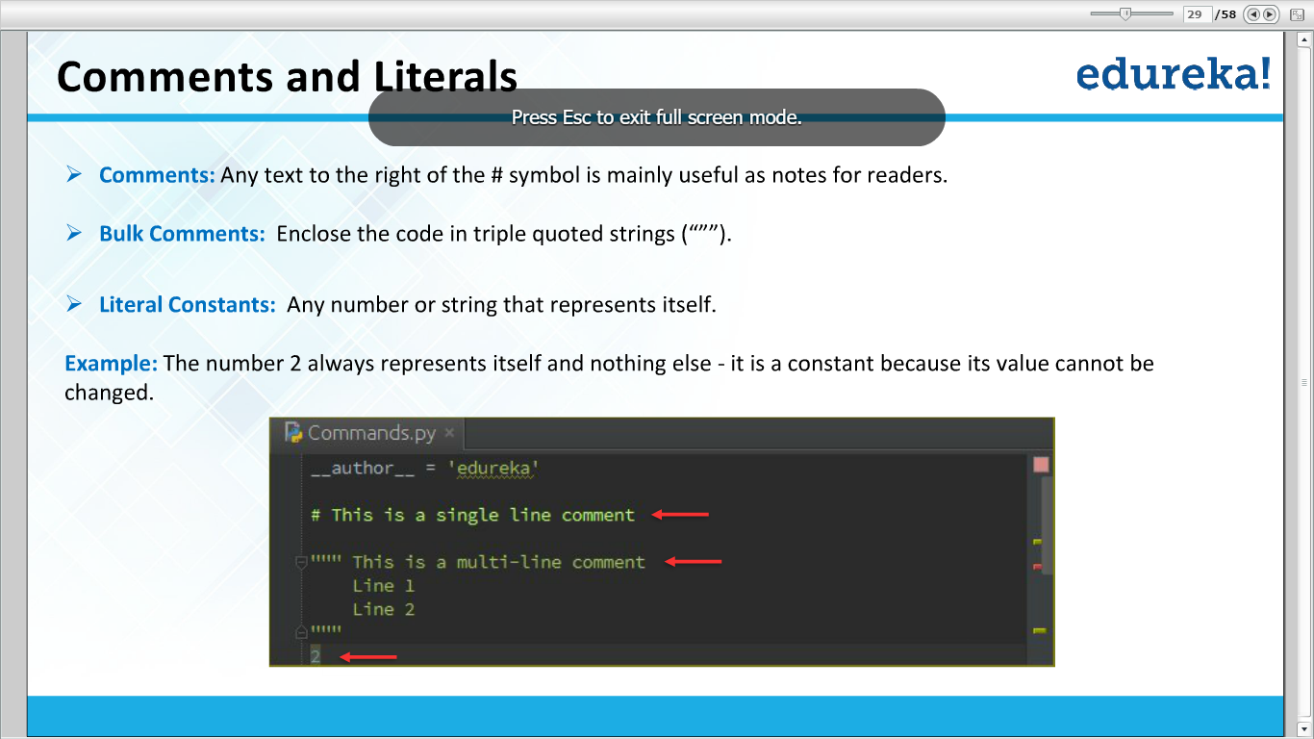

Slide 11
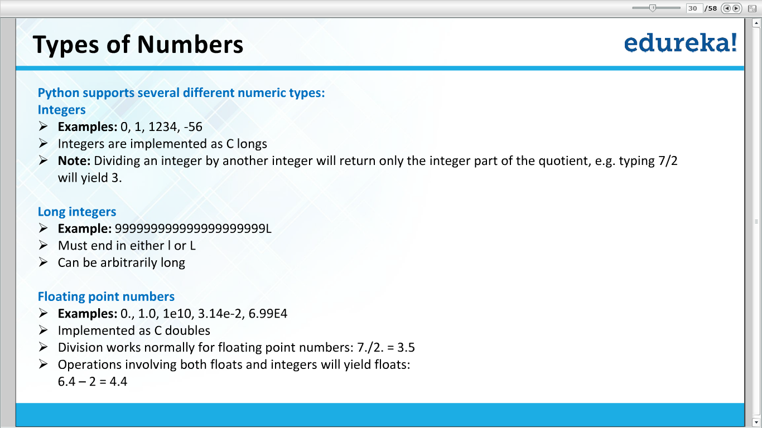

Slide 12
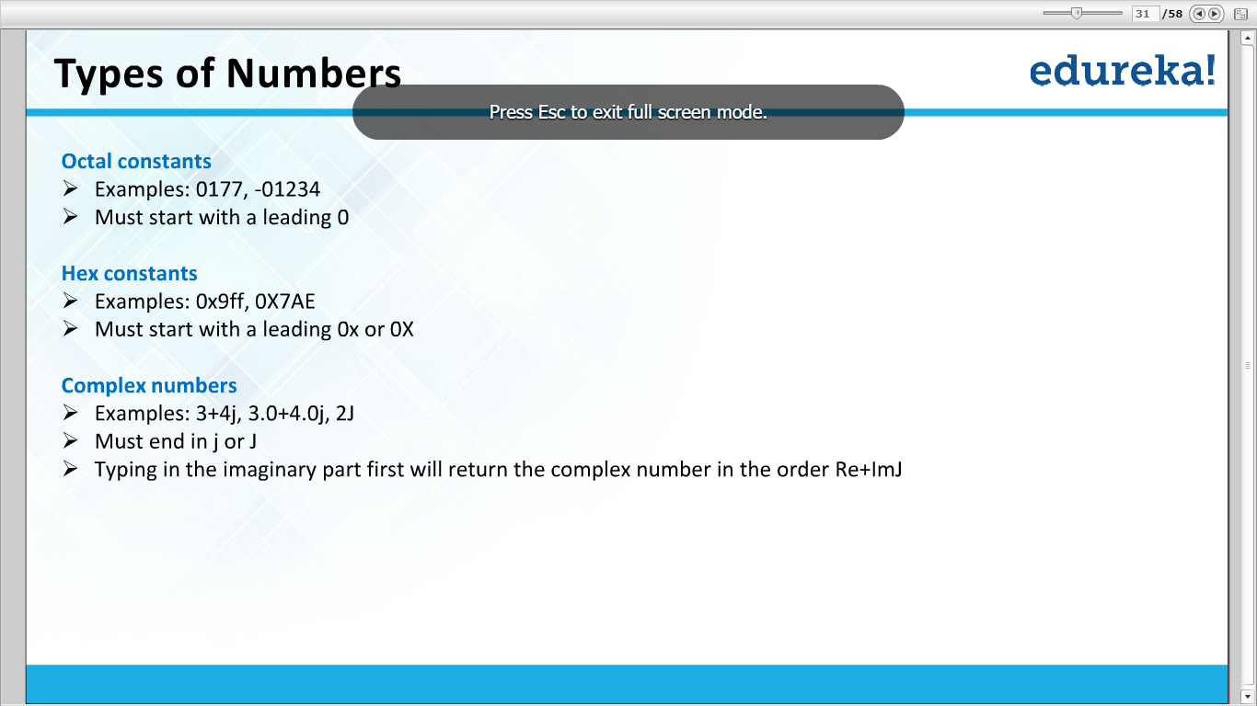

Slide 13
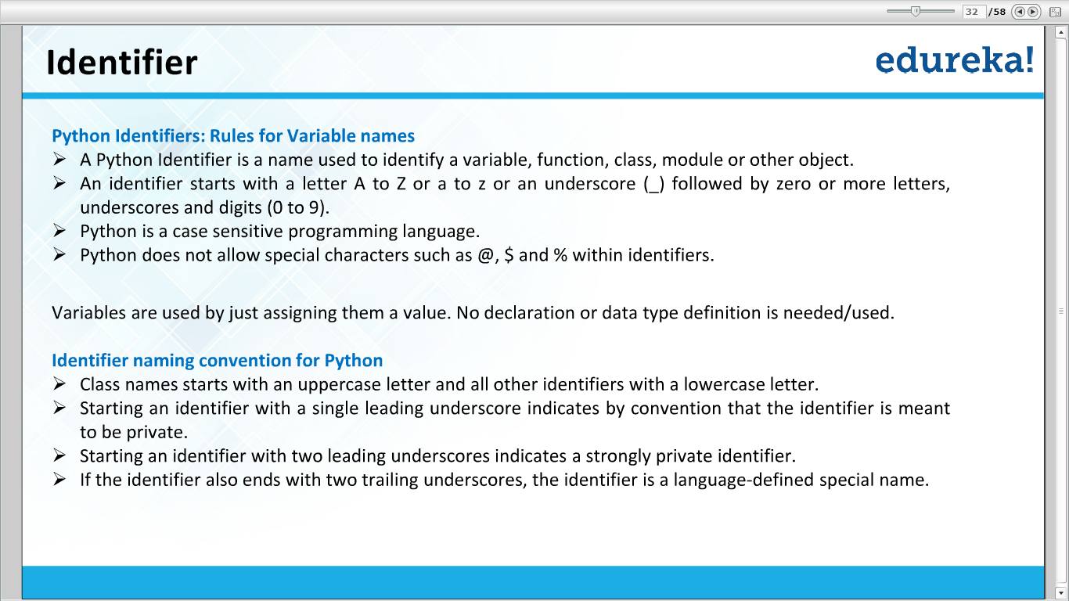

Slide 14
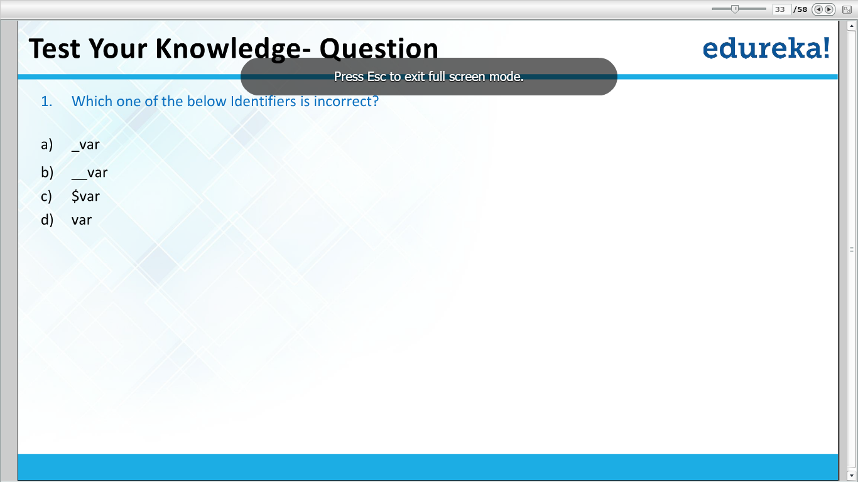

Slide 15
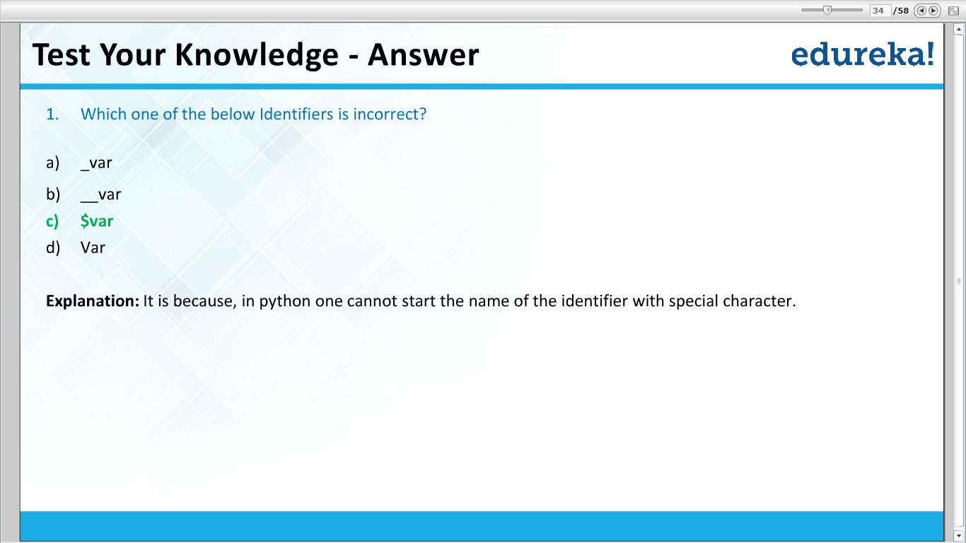

Slide 16


Slide 17
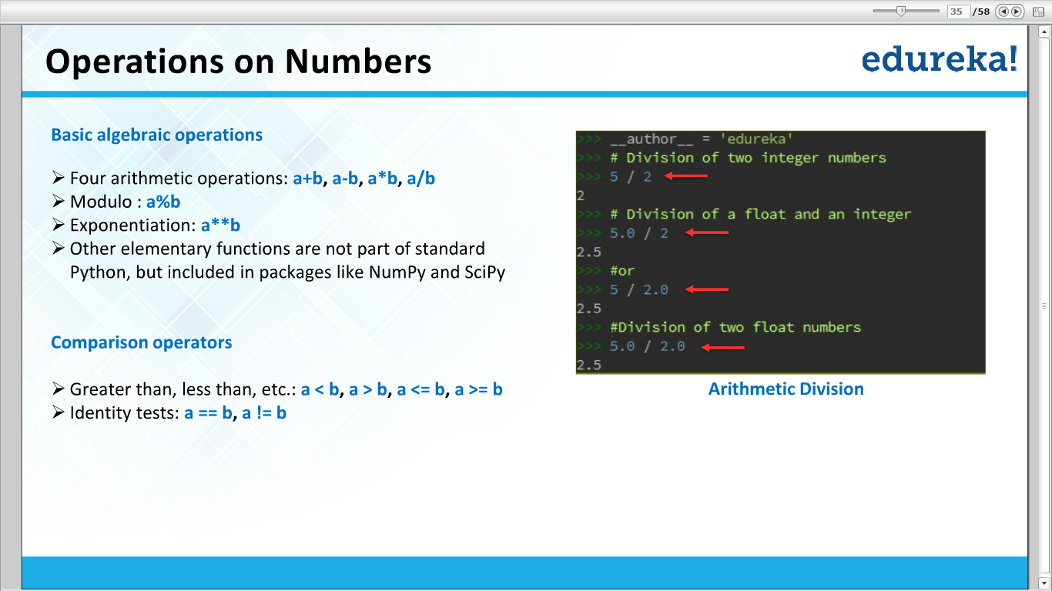

Slide 18
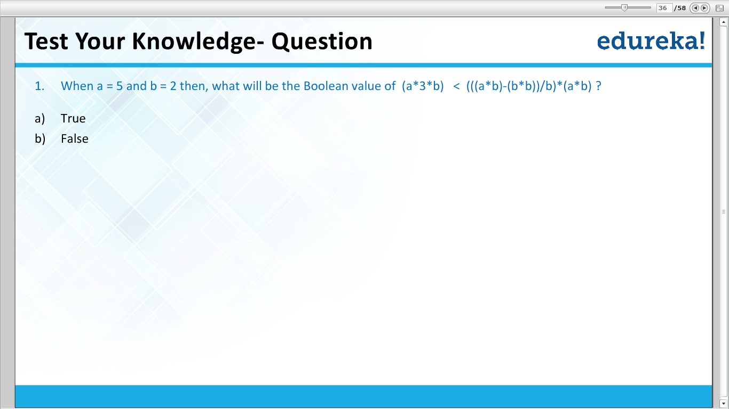

Slide 19
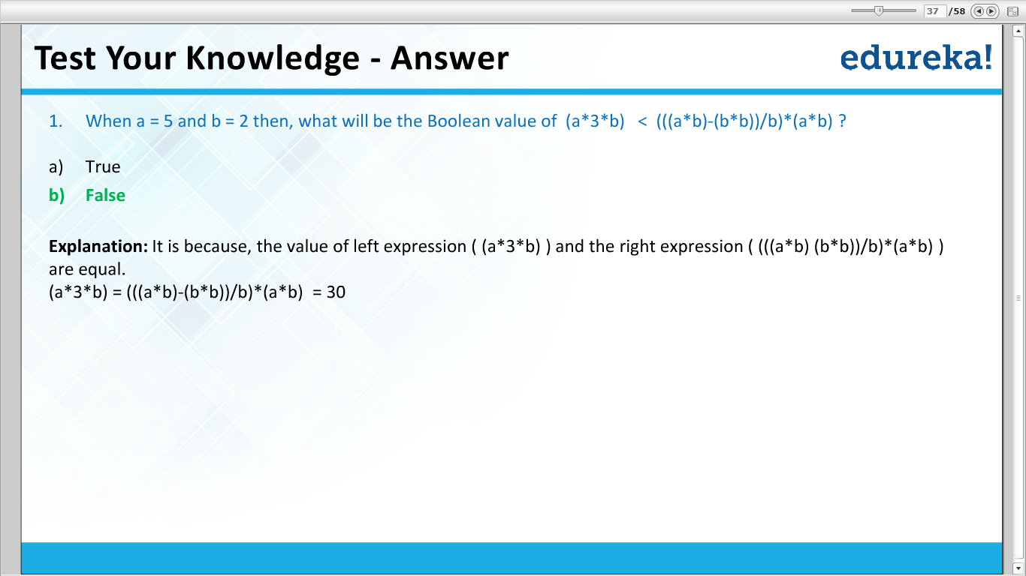

Slide 20
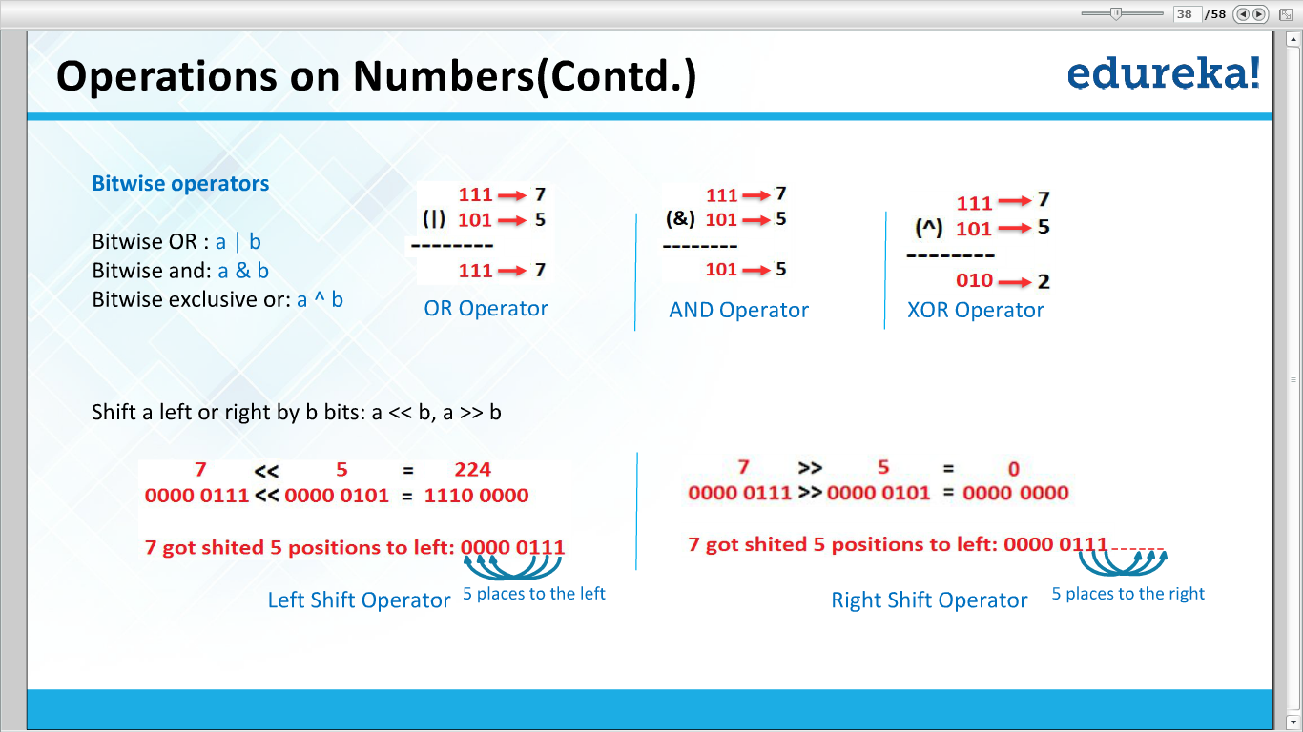

Slide 21
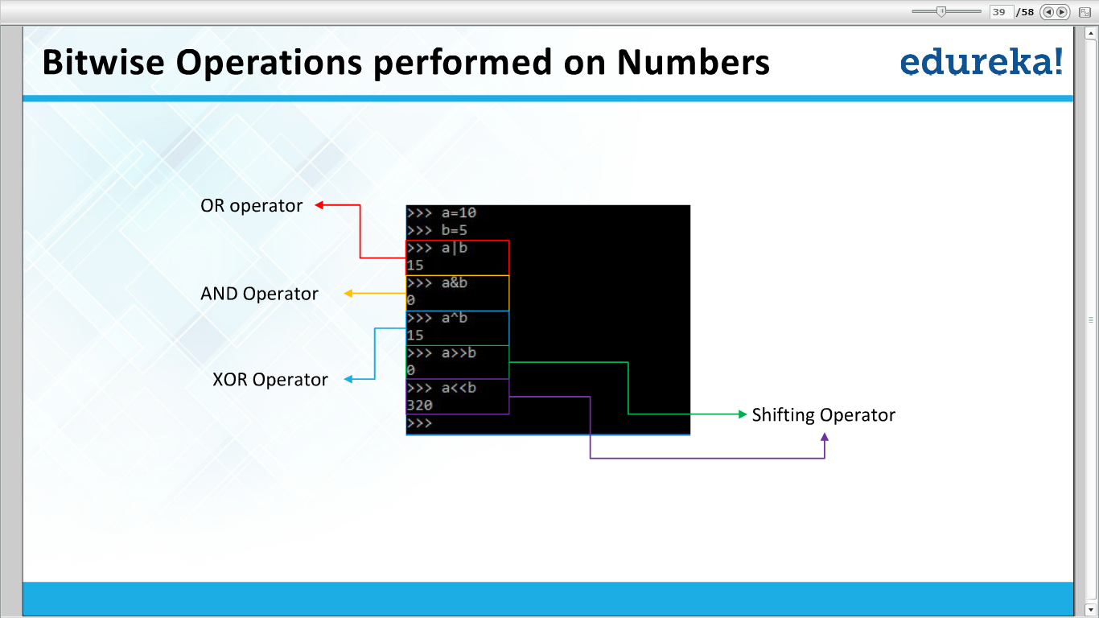

Slide 22
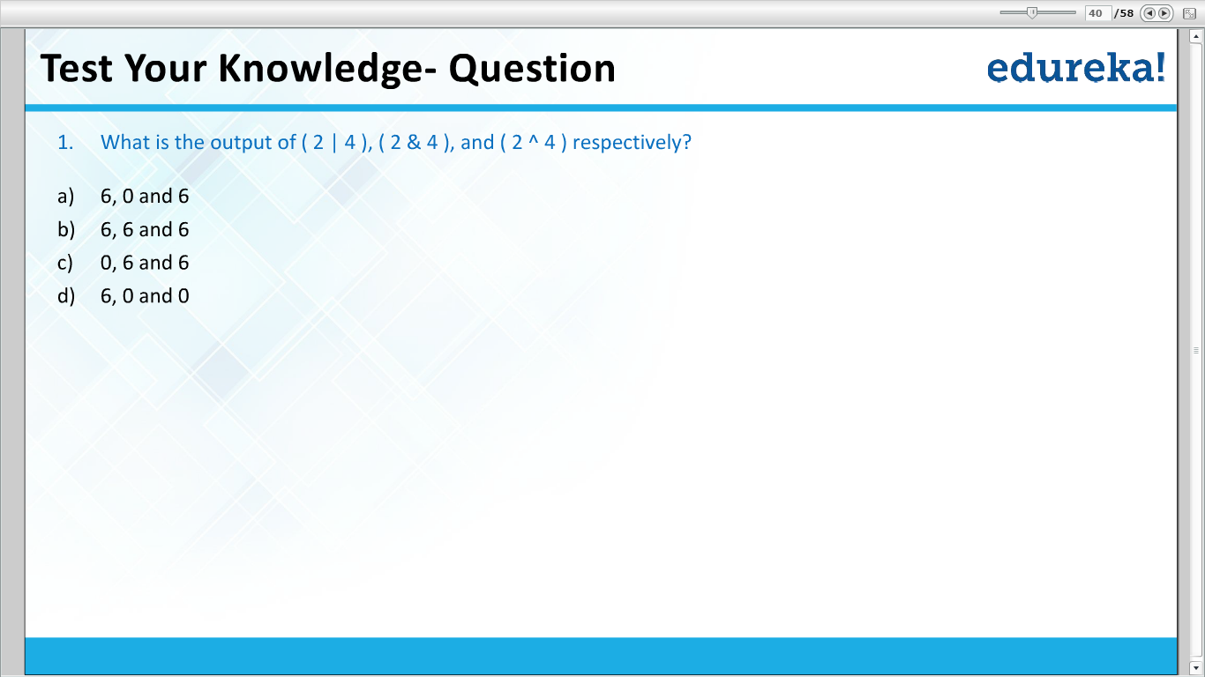

Slide 23


Slide 24
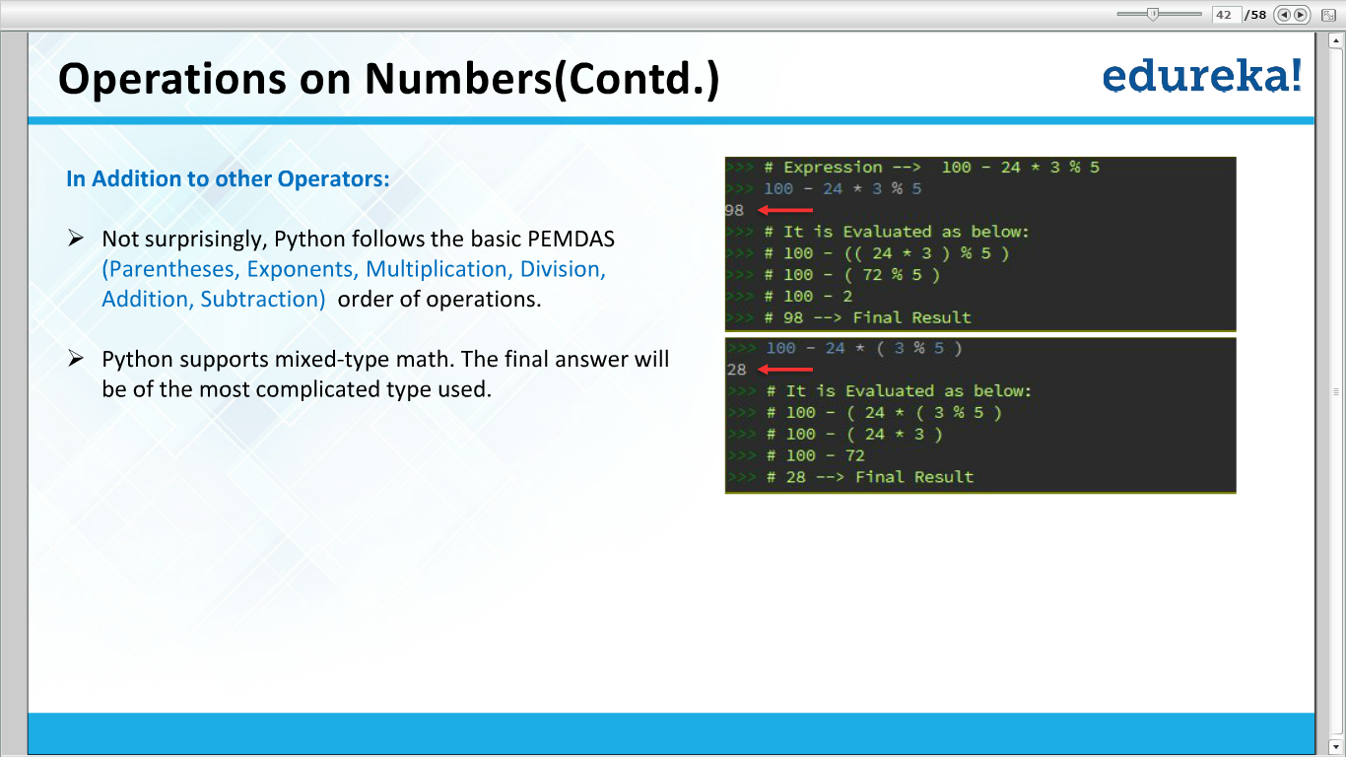

Slide 25
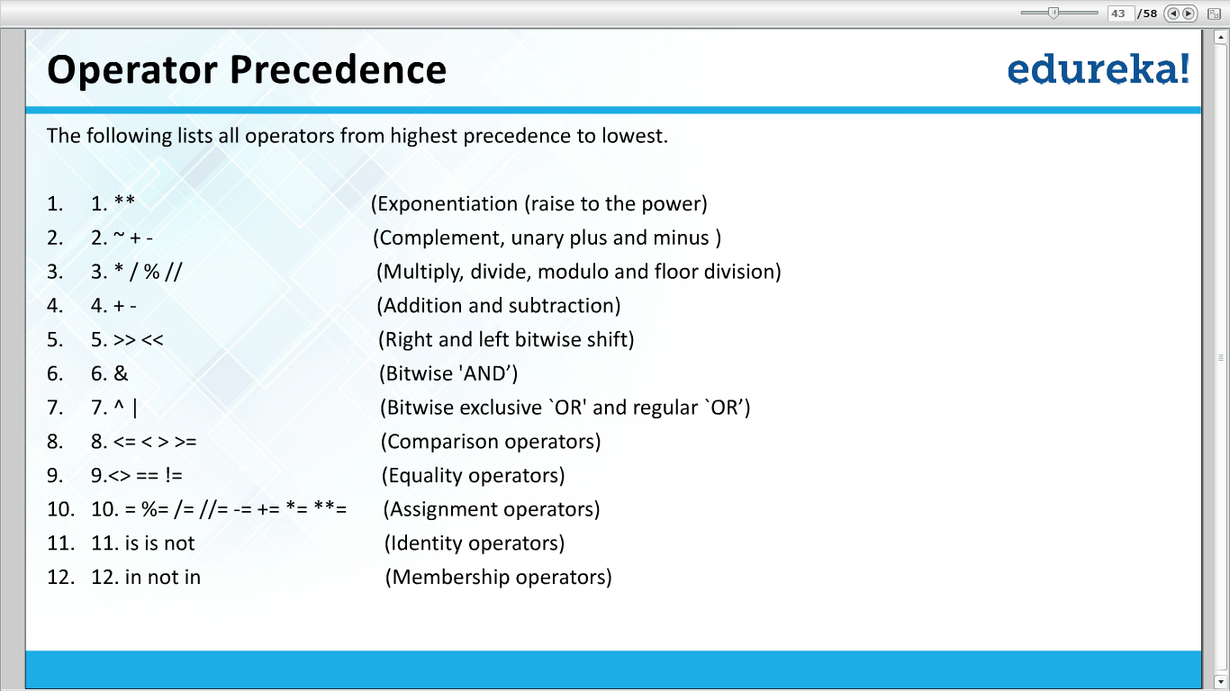

Slide 26
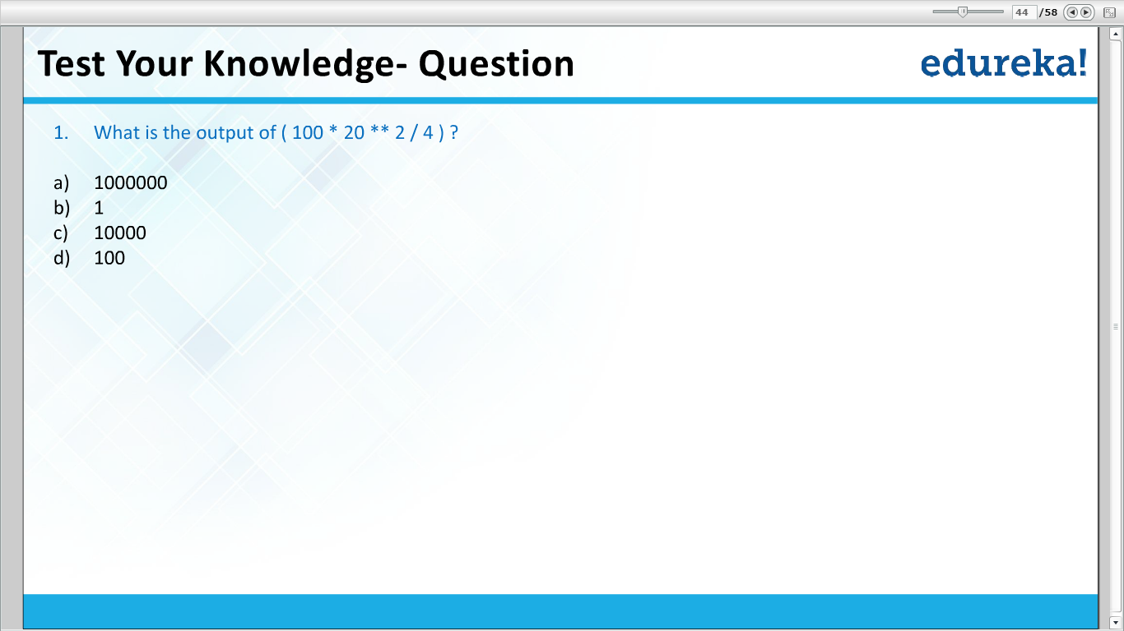

Slide 27
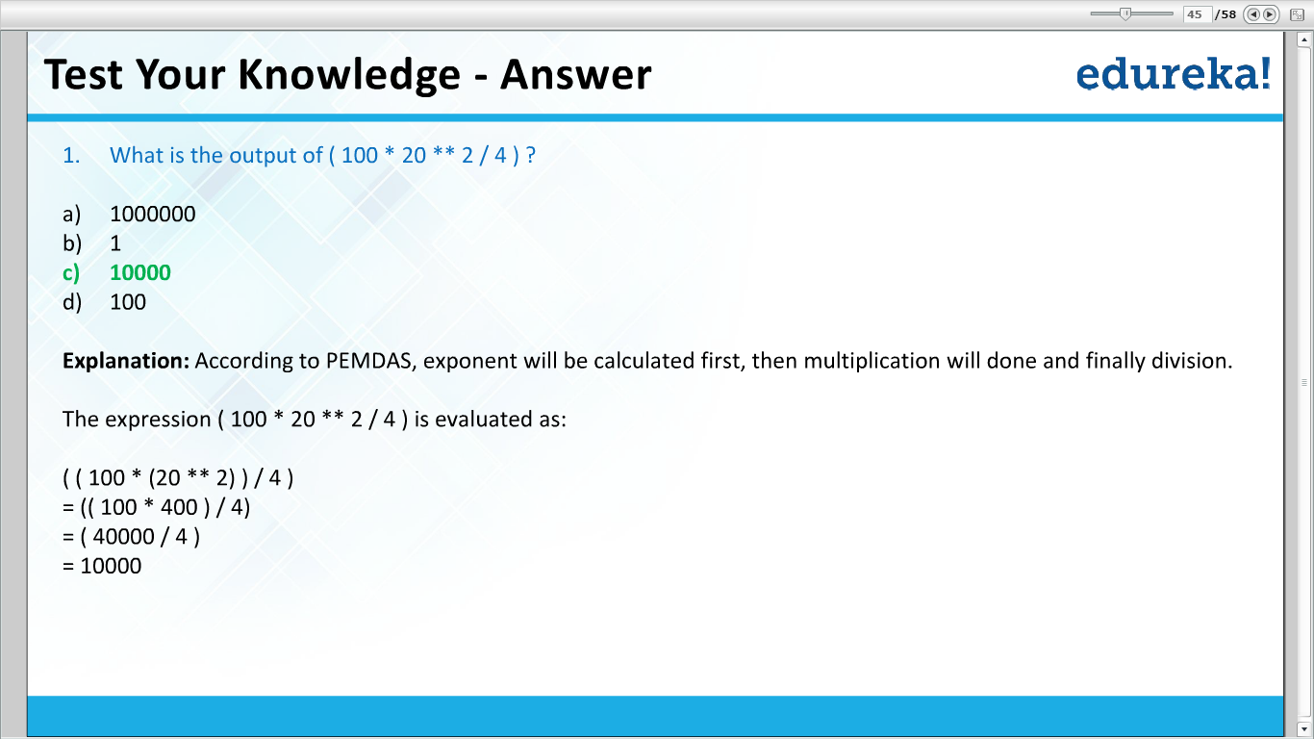

Slide 28
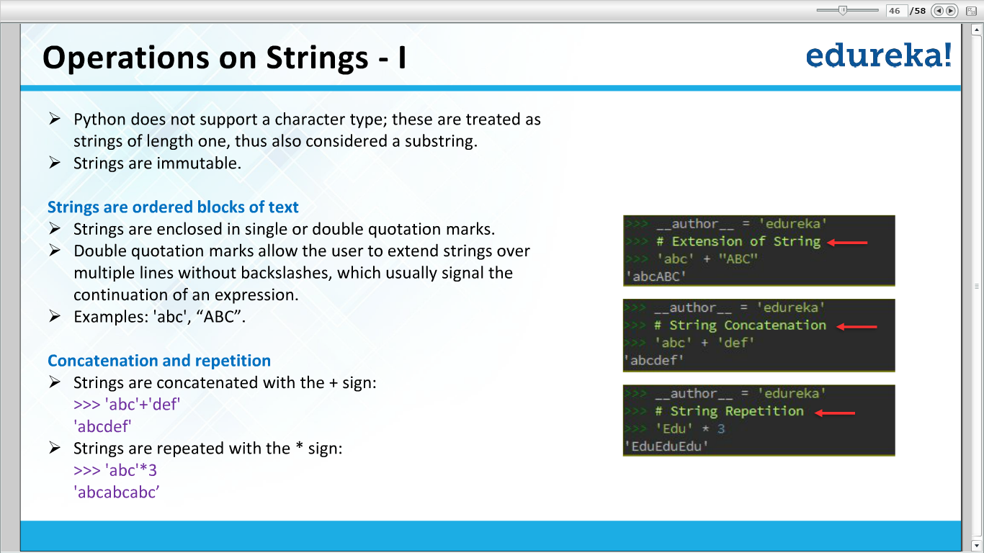

Slide 29
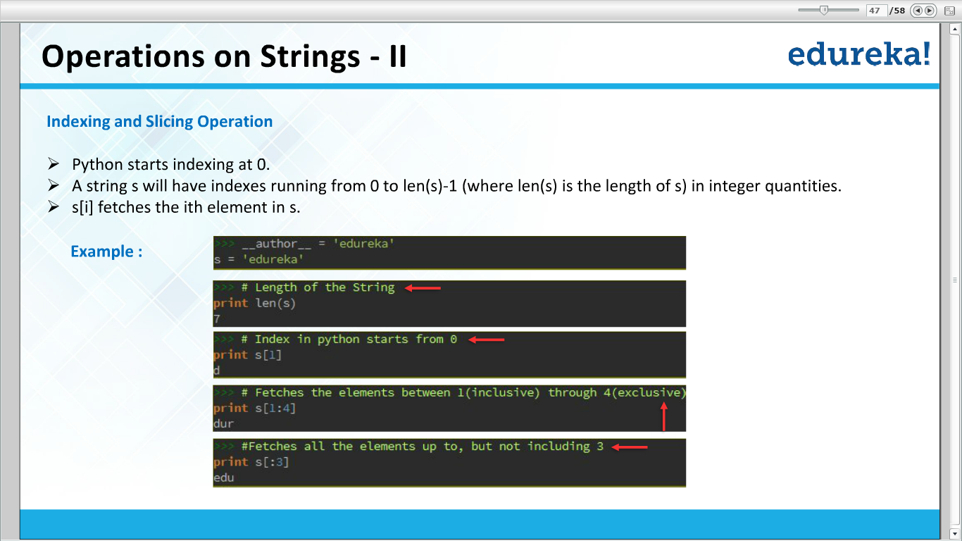

Slide 30
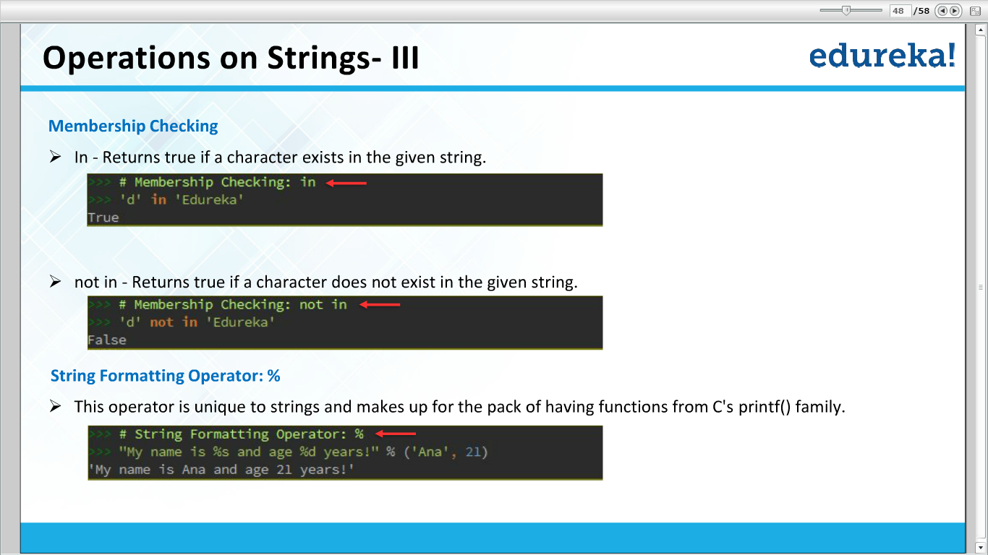

Slide 31
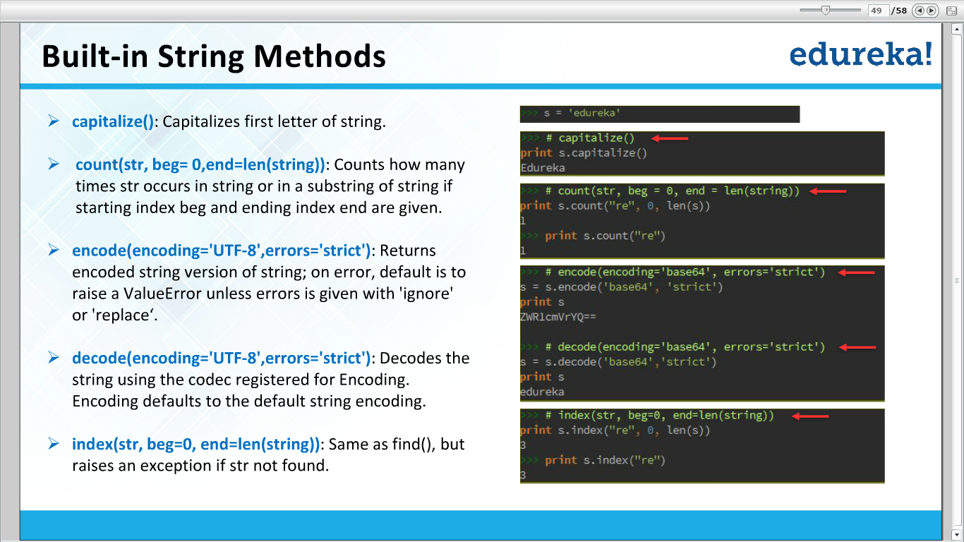

Slide 32
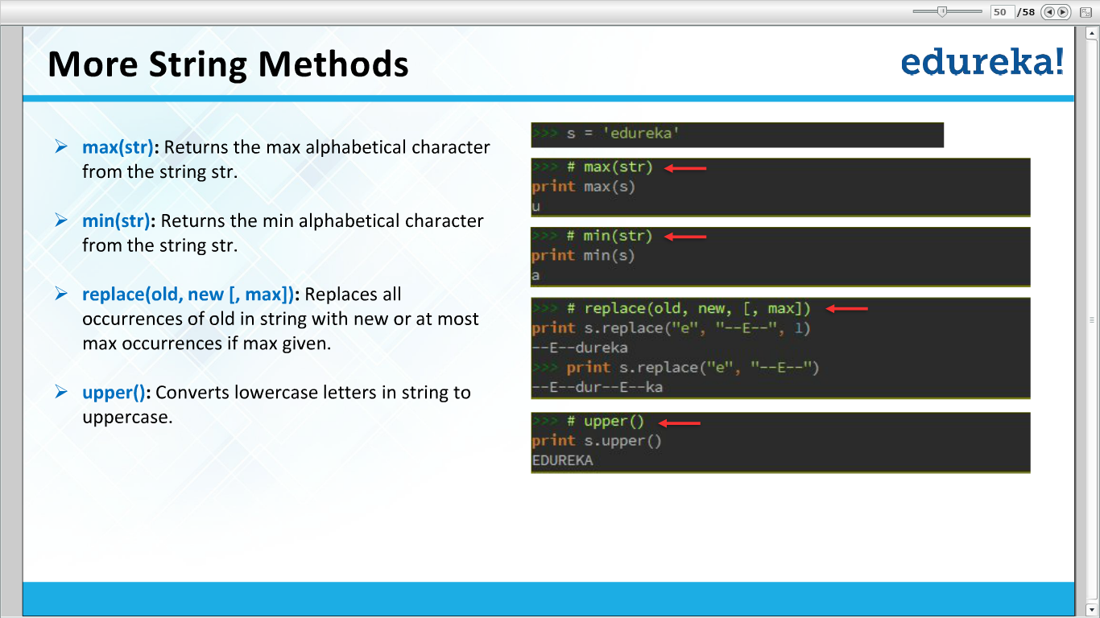

Slide 33
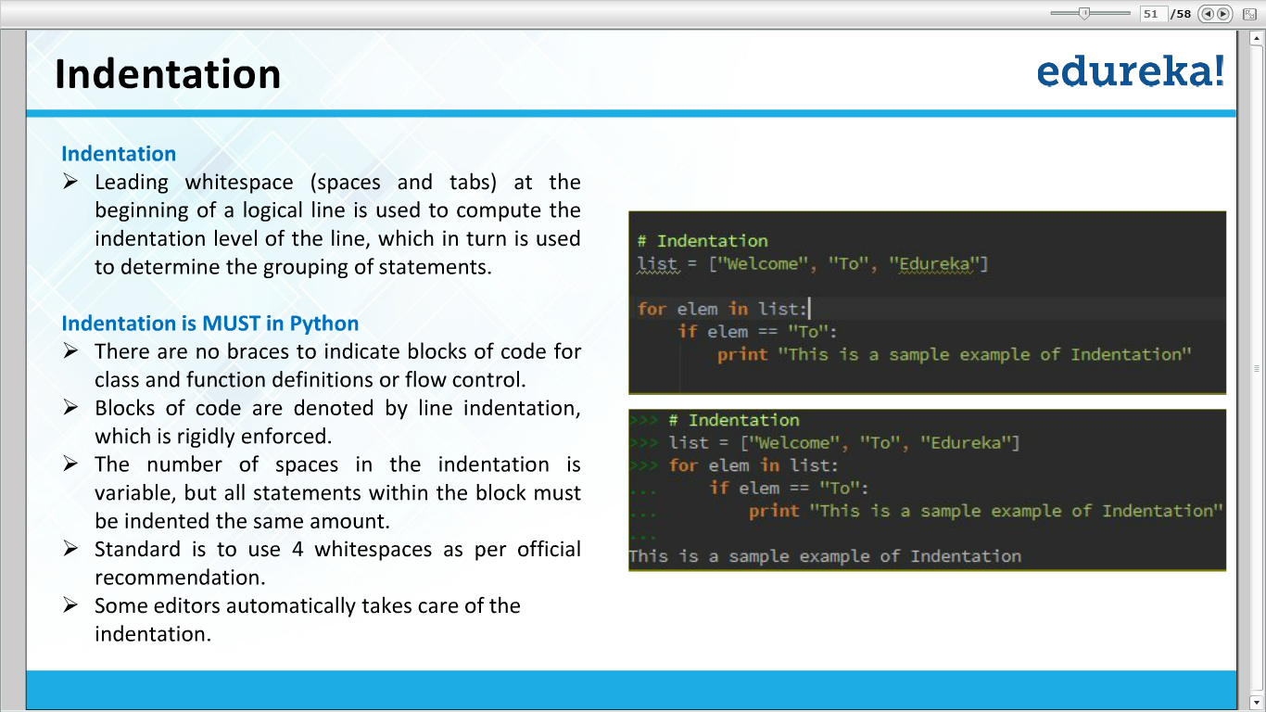

Slide 34
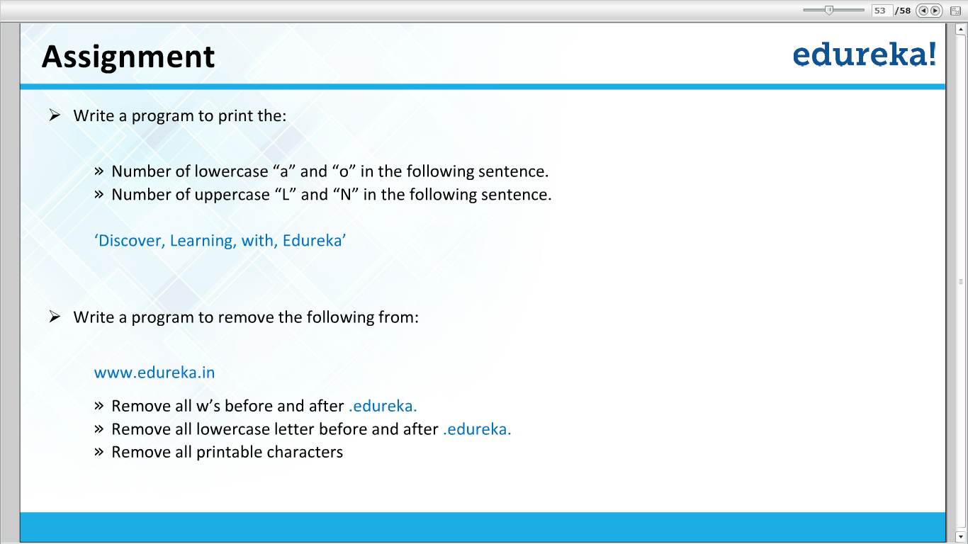

Slide 35
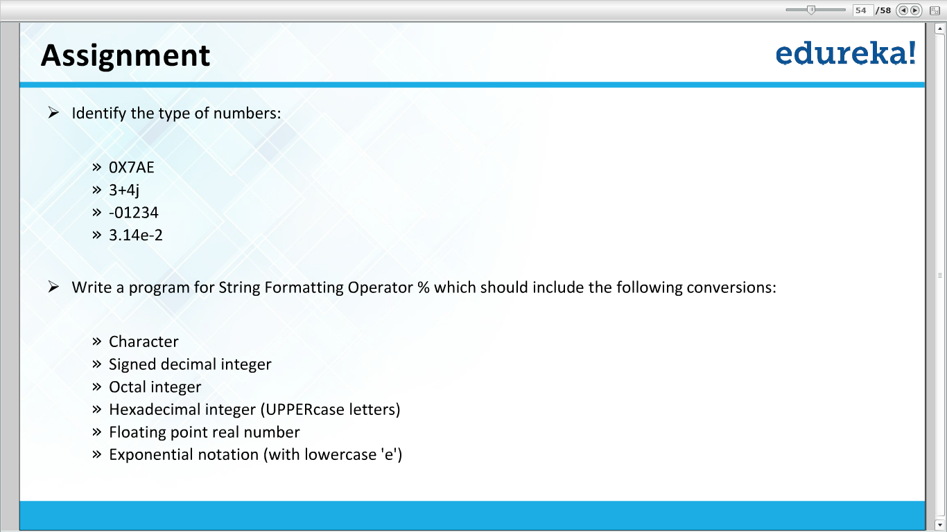

Slide 36
Thank You

